Slide 1
STATISTICS FOR DATA SCIENCE
Materials: https://bit.ly/2Kzo3nu
Sign-in: http://bit.ly/3558qMy
Code: 182639

Slide 2
What is Statistics?
The science centered around data collection and analysis in large quantities.
Collect
Analyze
Visualize
Model
Infer
We want to focus on the analysis and inference!

Slide 3
What this workshop will be:
A dive into the core statistical concepts applicable to Data Science:
Descriptive Statistics
Inferential Statistics
Understand how the libraries we know incorporate these concepts.

Slide 4
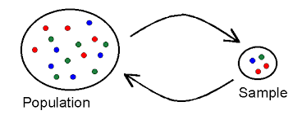
Terminology
Population: A finite, well-defined group of ALL objects. Can be enumerated.
Sample: A subset of the population

Slide 5
DESCRIPTIVE STATISTICS

Slide 6
CENTRAL TENDENCY MEASURES

Slide 7
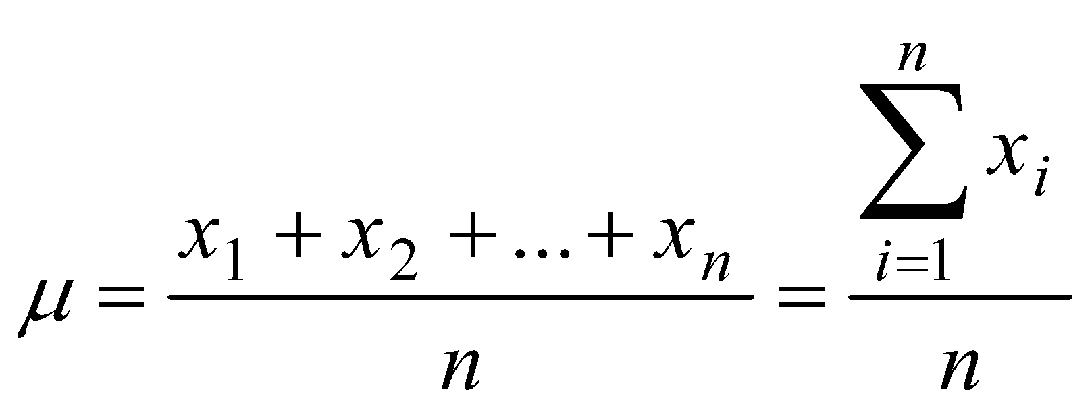
Mean
The average of the observations
NOT resistant to outliers!

Slide 8
Median
Observation such that 50% of the data is at or above this value.
Resistant to outliers!

Slide 9
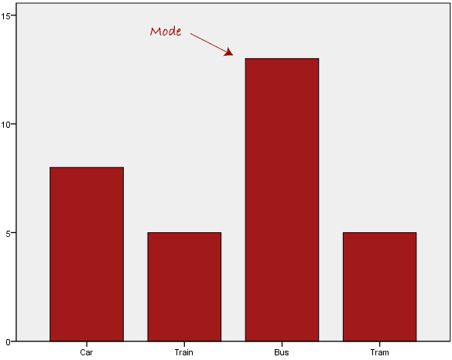
Mode
The observation with the highest frequency.

Slide 10
VARIABILITY MEASURES

Slide 11
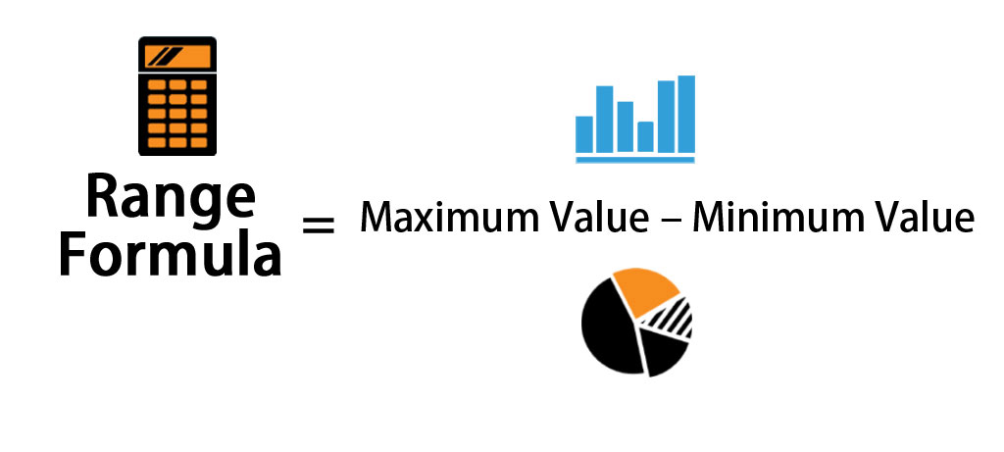
Range
The difference between the maximum and minimum observation.

Slide 12
Variance
The spread of the observations from the average value.

Slide 13
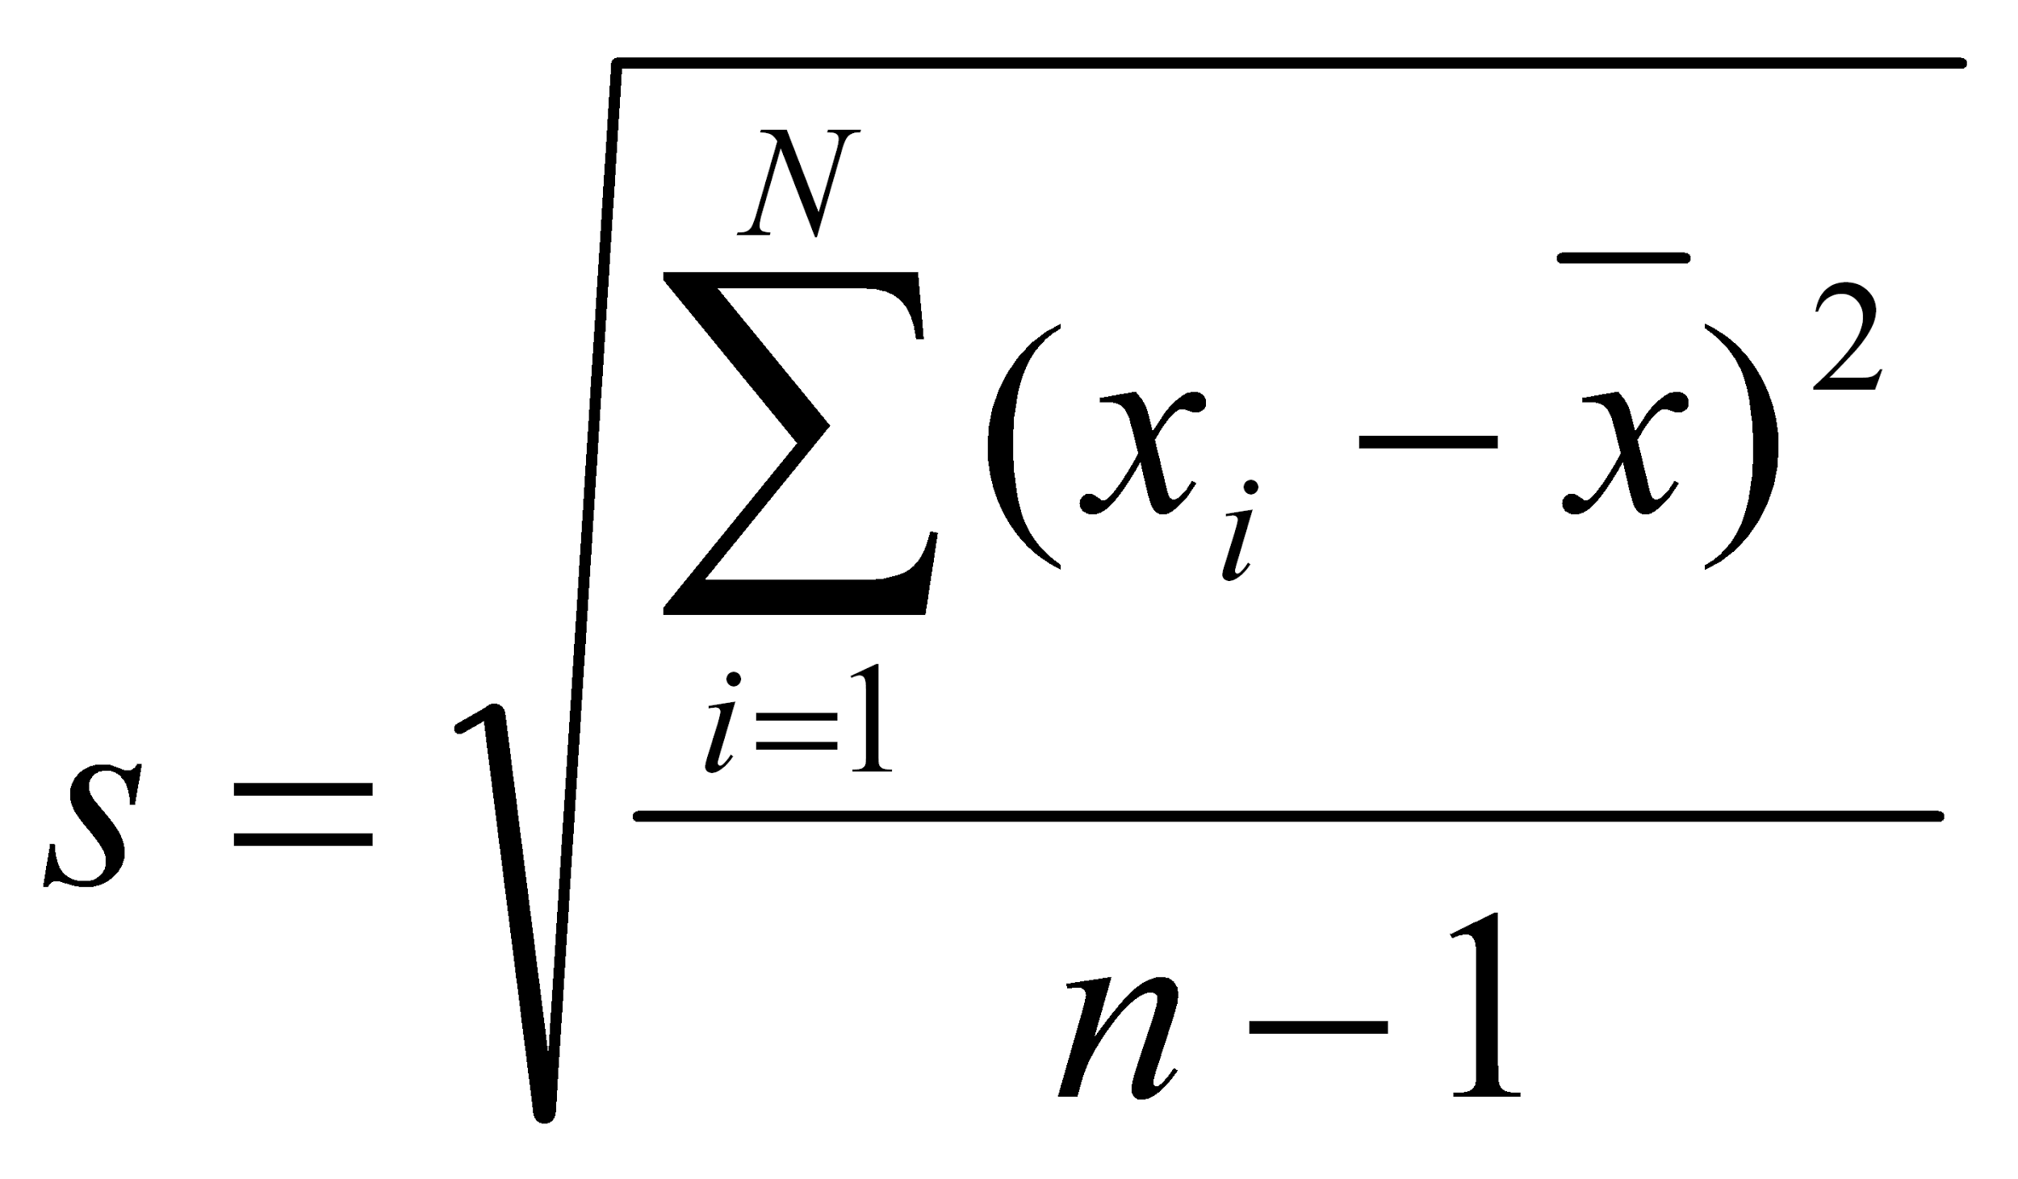
Standard Deviation
Square root of the Variance.

Slide 14
INFERENTIAL STATISTICS
Notes:
Distinguish between descriptive and inferential statistics. Explain more.

Slide 15
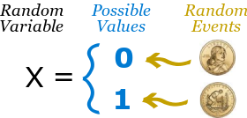
Random Variables
Variables whose values are dependent on chance events.

Slide 16
Statistic
A function of the observations in a random sample.

Slide 17
Sampling Distribution
The probability distribution of a statistic.
Let’s visualize a couple of them!

Slide 18
Types of Sampling Distributions
Normal Distribution
Chi-square distribution
t-distribution
F-distribution

Slide 19
The Central Limit Theorem (CLT)
Distribution of sample approximates a normal distribution if sample size is large enough!
https://seeing-theory.brown.edu/probability-distributions/index.html

Slide 20
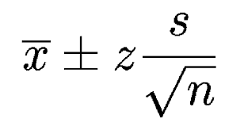
Confidence Intervals
A bound on the estimate of a population variable such as the mean or the variance.
Smaller CI: More precision
Larger CI: Less precision

Slide 21
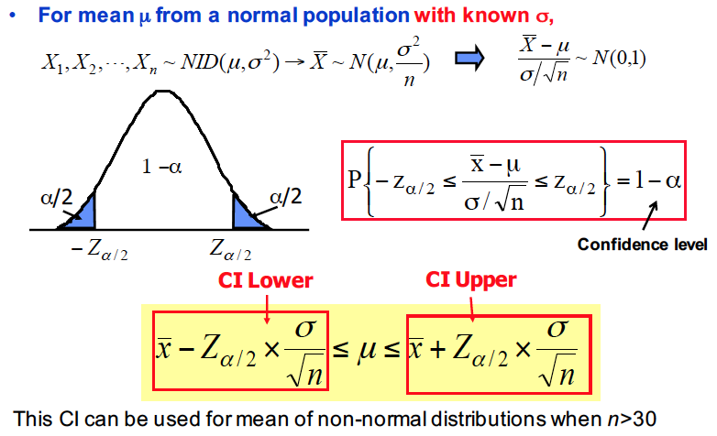

Slide 22
Hypothesis Testing
Given an initial claim about a parameter of one or more populations.
Rely on using information of a random sample from the population(s) of interest.

Slide 23
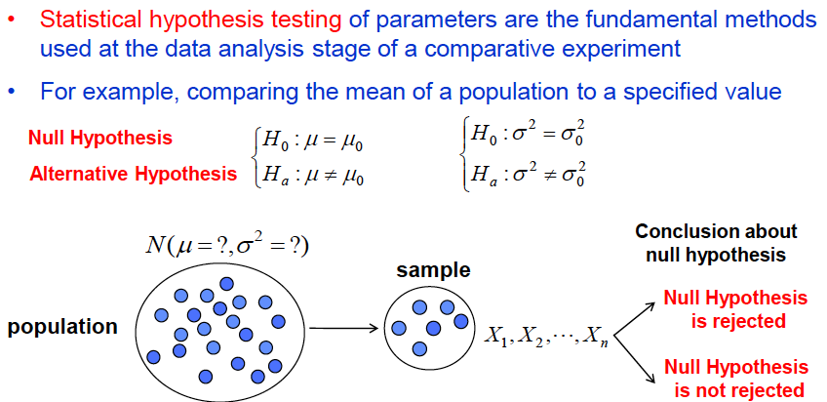

Slide 24
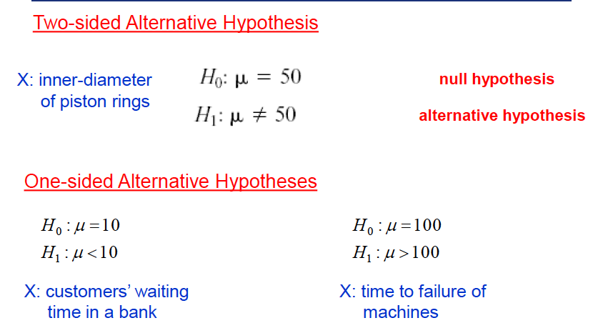
Types of Hypothesis Tests

Slide 25
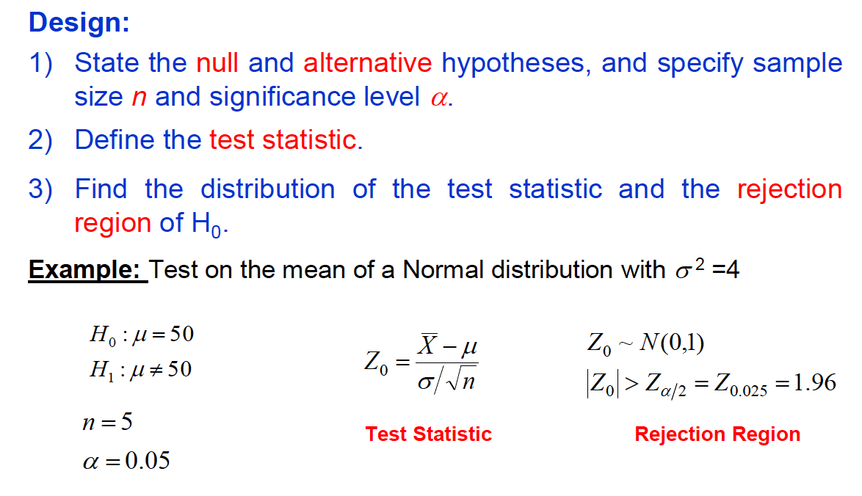
The Procedure

Slide 26
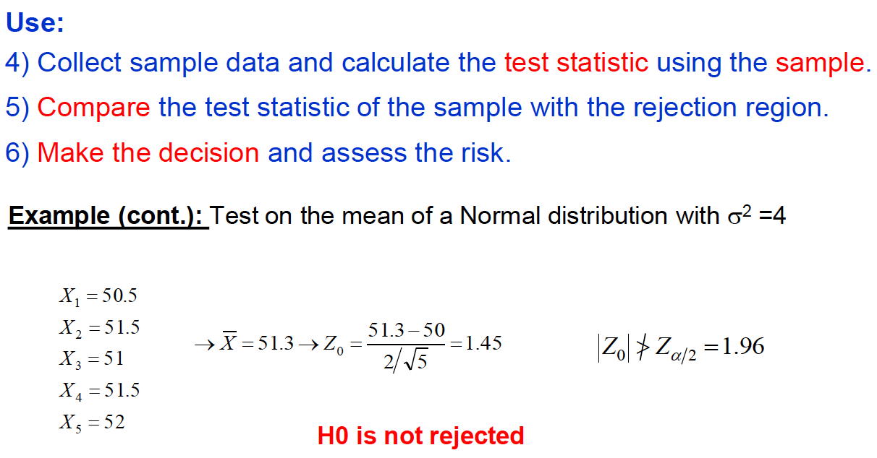
The Procedure

